Slide 1
Instructor Materials Chapter 9: Laptops and Mobile Devices
IT Essentials v6.0
Notes:
Cisco Networking Academy Program
IT Essentials
Chapter 9: Laptops and Mobile Devices

Slide 2
Instructor Materials - Chapter 9 Planning Guide
This PowerPoint is divided in two parts:
Instructor Planning Guide
Information to help you become familiar with the chapter
Teaching aids
Instructor Class Presentation
Optional slides that you can use in the classroom
Begins on slide #10
Note: Remove the Planning Guide from this presentation before sharing with anyone.
Notes:
2

Slide 3
ITE 6.0 Planning Guide
Chapter 9: Laptops and Mobile Devices
Notes:
ITE 6.0 Planning Guide
Chapter 9: Laptops and Mobile Devices

Slide 4
Chapter 9: Activities
What activities are associated with this chapter?
Page Number | Activity Type | Activity Name
9.1.1.6 | Lab | Research Docking Stations
9.2.1.3 | Interactive Activity (IA) | Match ACPI Standards
9.3.1.5 | Lab | Research Laptop RAM
9.3.2.3 | Lab | Research Laptop Batteries
9.3.2.5 | Lab | Research Laptop Screens
9.3.2.7 | Lab | Research Laptop Hard Drives
9.3.2.13 | Video | Replace Laptop Components
9.3.2.14 | Lab | Research Building a Specialized Laptop
9.4.1.6 | IA | Identify Connection Types
9.6.2.2 | Lab | Research Laptop Problems
9.6.2.3 | Lab | Gather Information from the Customer
9.6.2.4 | Lab | Investigate Support Websites
Notes:
4

Slide 5
Chapter 9: Assessment
Students should complete Chapter 9, “Assessment” after completing Chapter 9.
Quizzes, labs, and other activities can be used to informally assess student progress.
Notes:
5

Slide 6
Chapter 9: Best Practices
Prior to teaching Chapter 9, the instructor should:
Complete Chapter 9, “Assessment.”
The goal of this chapter is to provide an overview of laptops and mobile devices and provide the basics of preventive maintenance and troubleshooting on those devices.
Ensure that students understand that, just like desktop computers, laptops and mobile devices require periodic maintenance.
Make sure students understand that while electronic components experience less wear than mechanical components, all components will eventually fail due to normal operation.
Students may be discouraged by the troubleshooting process at first; make sure they understand it must be practiced and that it will take some time before they become experts.
Notes:
6

Slide 7
Chapter 9: Additional Help
For additional help with teaching strategies, including lesson plans, analogies for difficult concepts, and discussion topics, visit the ITE Community at community.netacad.net.
If you have lesson plans or resources that you would like to share, upload them to the ITE Community in order to help other instructors.
Notes:
7

Slide 8
Chapter 9: Topics in chapter that are not found in the CompTIA A+ 220-901 Certification
This slide lists content included in this chapter that is NOT listed in the CompTIA A+ 220-901 blueprint. Instructors could skip these sections; however, they should provide additional information and fundamental concepts to assist the student with the topic.
All content in Chapter 9 is aligned to the certification.
Notes:
8

Slide 9


Slide 10
Chapter 9: Laptops and Mobile Devices
IT Essentials v6.0
Notes:
Cisco Networking Academy Program
IT Essentials
Chapter 9: Laptops and Mobile Devices

Slide 11
Chapter 9 - Sections & Objectives
9.1 Laptop Components
Explain the purpose and characteristics of laptops.
9.2 Laptop Configuration
Explain how to configure laptop power settings and wireless settings.
9.3 Laptop Hardware and Component Installation and Configuration
Explain how to remove and install laptop components.
9.4 Mobile Device Hardware Overview
Explain the purpose and characteristics of mobile devices.
9.5 Common Preventive Maintenance Techniques for Laptops and Mobile Devices
Explain how to perform common preventive maintenance techniques for laptops and mobile devices.
9.6 Basic Troubleshooting Process for Laptops and Mobile Devices
Explain how to troubleshoot laptops and mobile devices.
9.6 Chapter Summary
Notes:
11

Slide 12
9.1 Laptop Components
Notes:
Cisco Networking Academy Program
IT Essentials
Chapter 9: Laptops and Mobile Devices

Slide 13
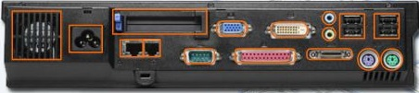
Laptops and Mobile Devices Laptop Components
Features of Laptop Components
External Features Unique to Laptops
Battery, Security keyhole, Docking Connector
Common Input Devices and LEDs in Laptops
Touchpad, Pointing stick, Keyboard, Fingerprint readers, Microphone, Web camera, LED indicators
Internal Components
Motherboards, RAM (SODIMMs), CPUs, Storage
Special Function Keys
Display settings, Media options, Sleep states, WI-FI & Bluetooth functionality
Docking Station vs. Port Replicator
Both add ports to laptop. Docking Station adds the ability to connect to PCI cards, additional hard drives, and optical drives.
Notes:
9.1 – Laptop Components
9.1.1 – Features of Laptop Components

Slide 14
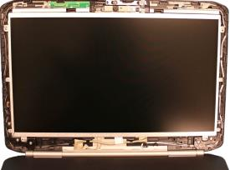
Laptops and Mobile Devices Laptop Components
Laptop Displays
LCD, LED, and OLED Displays
2 types of LCD: Twisted Nematic (TN) and In-Plane Switching (IPS)
TN: Offer high brightness, uses less power than IPS, inexpensive
IPS: Better color reproduction and better viewing angles
LEDs: Use less power and have longer lifespan
OLED: Commonly used for mobile devices and digital cameras
Backlights and Inverters
LCD: Cold Cathode Fluorescent Lamp (CCFL) & Inverter
LED: LED based backlights
WI-FI Antenna Connectors
Typically located above the screen
Connects to wireless card
Webcam and Microphone
Built into most laptops today
Notes:
9.1 – Laptop Components
9.1.2 – Laptop Displays

Slide 15
9.2 Laptop Configuration
Notes:
Cisco Networking Academy Program
IT Essentials
Chapter 9: Laptops and Mobile Devices

Slide 16
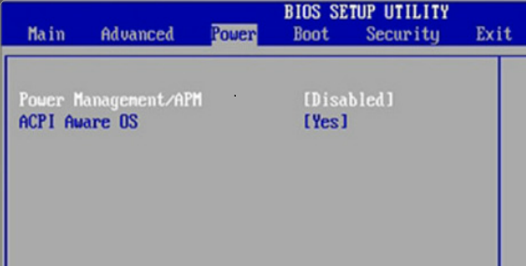
Laptops and Mobile Devices Laptop Configuration
Power Settings Configuration
Power Management
Advanced Configuration and Power Interface (ACPI) standards
Creates a bridge between hardware and Operating System
Provides power management schemes for better performance
Standards: S0 – S5
Managing ACPI Settings in the BIOS
Managing Laptop Power Options
Sleep
Hibernate
Shutdown
Notes:
9.2 – Laptop Configuration
9.2.1 – Power Settings Configuration

Slide 17
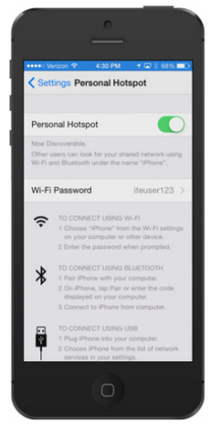
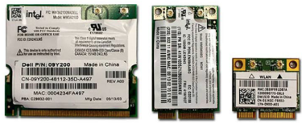
Laptops and Mobile Devices Laptop Configuration
Wireless Configuration
Bluetooth
Personal Area Network (PAN)
3 Classes: Most common is Class 2 with a range of approx. 33 feet
4 Specifications: Version 4 is newest with more advanced capabilities
Supports 128-bit encryption and PIN authentication
Cellular WAN
Tethering: Can be made using Wi-Fi, Bluetooth, or USB cable
Laptops can have integrated cellular WAN capabilities.
WI-FI
Mini-PCI: older laptops, 124 pins, 802.11a, 802.11b, and 802.11g
Mini-PCIe: Most common, 54 pins, all 802.11 standards
PCI Express Micro: ½ size of Mini-PCIe, 54 pin, all 802.11 standards
Notes:
9.2 – Laptop Configuration
9.2.2 – Wireless Configuration

Slide 18
9.3 Laptop Hardware and Component Installation and Configuration
Notes:
Cisco Networking Academy Program
IT Essentials
Chapter 9: Laptops and Mobile Devices

Slide 19
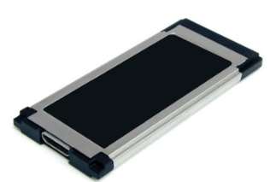
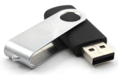
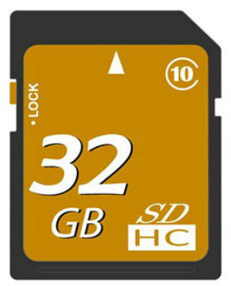
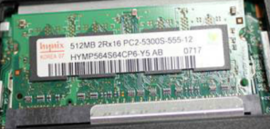
Laptops and Mobile Devices Laptop Hardware and Component Installation and Configuration
Expansion Slots
Expansion Cards
2 Models: ExpressCard/34 & ExpressCard/54
Add functionality to laptop: Additional memory card reader, External hard drive access, TV tuner cards, USB and FireWire ports, Wi-Fi Connectivity
Flash Memory
External Flash Drive (SSD)
Flash Cards (SD, SDHC)
Smart Card Readers
Contact – requires a physical connection to the card
Contactless – works on a radio frequency
SODIMM Memory
32-bit: 72-pin and 100-pin
64-bit: 144-pin, 200-pin, and 204-pin
Notes:
9.3 - Laptop Hardware and Component Installation and Configuration
9.3.1 - Expansion Slots

Slide 20
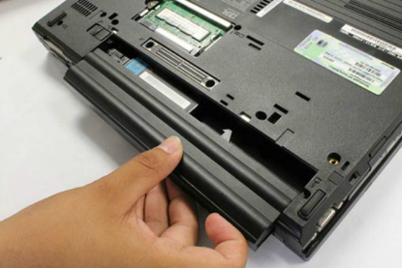
Laptops and Mobile Devices Laptop Hardware and Component Installation and Configuration
Replacing Hardware Devices
Overview of Hardware Replacement
Customer-Replaceable Units (CRUs)
Field-Replaceable Units (FRUs)
Power
Most batteries are CRU
Signs Battery needs to be replaced: Does not hold charge, overheats, leaking
Keyboard, Touchpad, and Screens
Internal Storage Drive and Optical Drive
Wireless Card
Speakers
CPU
Motherboard
Plastic Frames
Notes:
9.3 - Laptop Hardware and Component Installation and Configuration
9.3.2 - Replacing Hardware Devices

Slide 21
9.4 Mobile Device Hardware Overview
Notes:
Cisco Networking Academy Program
IT Essentials
Chapter 9: Laptops and Mobile Devices

Slide 22
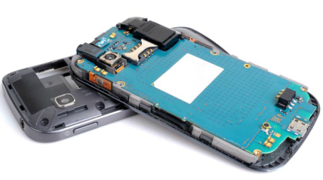
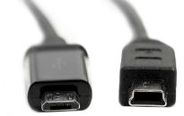
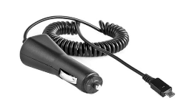
Laptops and Mobile Devices Mobile Device Hardware Overview
Mobile Device Hardware
Mobile Device Parts
Non-Upgradeable Hardware
Touchscreens
Recognize two or more points of contact
Common Gestures: Swipe, Double touch, Long touch, Scroll, Pinch, Spread
Solid State Drives
Advantages: Power efficiency, Reliability, Lightweight, Compact, Performance, No noise
Connection Types
Wired: Micro/Mini USB, Lightning, Proprietary vendor specific ports
Wireless: NFC, IR, Bluetooth
Accessories
External Battery
Docking Station
Portable Chargers
Ear Buds
Headsets
Speakers
Game Pad
SD cards
Credit Card Reader
Notes:
9.4 - Mobile Device Hardware Overview
9.4.1 – Mobile Device Hardware

Slide 23
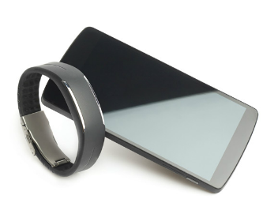
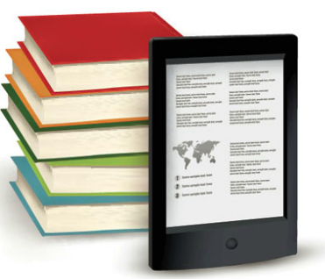
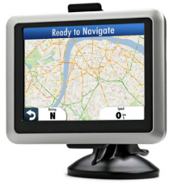
Laptops and Mobile Devices Mobile Device Hardware Overview
Other Mobile Devices
Wearable Devices
Smart Watches
Fitness Monitors
Smart Headsets
Specialty Devices
GPS Receiver
Smart Cameras
Electronic Readers
Notes:
9.4 - Mobile Device Hardware Overview
9.4.2 – Other Mobile Devices

Slide 24
9.5 Common Preventive Maintenance Techniques for Laptops and Mobile Devices
Notes:
Cisco Networking Academy Program
IT Essentials
Chapter 9: Laptops and Mobile Devices

Slide 25
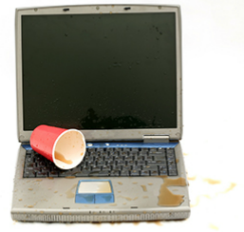
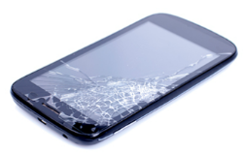
Laptops and Mobile Devices Common Preventive Maintenance Techniques for Laptops and Mobile Devices
Scheduled Maintenance for Laptops and Mobile Devices
Scheduled Maintenance
More exposure
Laptops
Cleaning
Hard drive maintenance
Software updates
Mobile Devices
Cleaning
Backing up the data
Updating the system and applications
Dirt and contamination
Spills
Wear and tear
Drops
Excessive heat & cold
Excessive moisture
Notes:
9.5 – Common Preventive Maintenance Techniques for Laptops and Mobile Devices
9.5.1 – Scheduled Maintenance for Laptops and Mobile Devices

Slide 26
9.6 Basic Troubleshooting Process for Laptops and Mobile Devices
Notes:
Cisco Networking Academy Program
IT Essentials
Chapter 9: Laptops and Mobile Devices

Slide 27
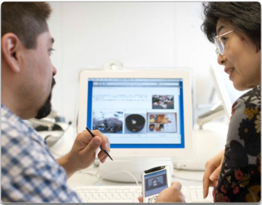
Laptops and Mobile Devices Basic Troubleshooting Process for Laptops and Mobile Devices
Applying
Identify the Problem
Open-ended questions
Closed-ended questions
Establish a Theory of Probably Cause
Test the Theory to Determine Cause
Establish a Plan of Action to Resolve the Problem and Implement the Solution
Verify Full System Functionality and Implement Preventive Measures
Document Findings, Actions, and Outcomes
Common Problems and Solutions for Laptops and Mobile Devices
Identify Common Problems and Solutions
Notes:
9.6 - Basic Troubleshooting Process for Laptops and Mobile Devices
9.6.1 – Applying
9.6.2 - Common Problems and Solutions for Laptops and Mobile Devices

Slide 28
9.7 Chapter Summary
Notes:
Cisco Networking Academy Program
IT Essentials
Chapter 9: Laptops and Mobile Devices

Slide 29
Chapter Summary Summary
This chapter discussed the features and functionality of laptops and mobile devices, as well as how to remove and install internal and external components. The following concepts from this chapter are important to remember:
Laptops and mobile devices are lightweight and can operate on battery power.
Laptops use the same types of ports as desktop computers so that peripheral devices can be interchangeable. Mobile devices can also use some of the same peripheral devices.
Essential input devices, such as a keyboard and track pad, are built into laptops to provide similar functionality as desktop computers. Some laptops and mobile devices use touchscreens as input devices.
The internal components of laptops are typically smaller than desktop components because they are designed to fit into compact spaces and conserve energy. The internal components of mobile devices are usually connected to the circuit board to keep the device compact and light weight.
Laptops feature function keys that can be pressed in combination with the Fn key. The functions performed by these keys are specific to the laptop model.
Docking stations and port replicators can increase the functionality of laptops by providing the same types of ports that are featured on desktop computers. Some mobile devices use docking station to charge or use peripheral devices.
Notes:
9.7.1 - Summary

Slide 30
Chapter Summary Summary (Cont.)
Laptops and mobile devices most commonly feature LCD and LED monitors or touchscreens.
Backlights and inverters illuminate laptop displays.
The power settings of laptop batteries can be configured to ensure that power is used efficiently.
Laptops and mobile devices can feature a number of wireless technologies, including Bluetooth, Infrared, Wi-Fi and the ability to access Cellular WANs.
Laptops provide a number of expansion possibilities. Users can add memory to increase performance, make use of flash memory to increase storage capacity, or increase functionality by using expansion cards. Some mobile devices can add more storage capacity by upgrading or adding more flash memory, such as MicroSD cards.
Laptop components consist of CRUs and FRUs.
Laptop components should be cleaned regularly in order to extend the life of the laptop.
Notes:
9.7.1 - Summary

Slide 32


Slide 33
Chapter 9 New Terms and Commands
acpi
airplane (phone mode)
backlight
ccfl
ddr
ddr2
ddr3
dimm
diode
displayports
emmc
esata
expresscard
firewire
ips
lcd
microsd
nfc
oled
touchscreen
passkey
phablet
sd
sdhc
smartwatch
sodimm
tethering
ultrabooks
wearable
Notes:
New Terms and Commands

